Slide 1

The Classification of Suburbs in Victoria, Australia
By Angel W

Slide 2
Introduction
In this project we will try to compare different suburbs in Victoria, Australia.
This report will be targeted to people interested in moving into one of the suburbs in Victoria, Australia.
For analysis purposes, we will group the suburbs based on the occurrences of venues from different categories, this will then be converted into a easily understandable visual representation that shows the distribution of different types of suburbs so that the individuals interested in moving into the suburbs in Victoria can choose the best type of suburb that suits their needs.

Slide 3
Data acquisition and cleaning
The names and geographical locations of the suburbs in Victoria, Australia are obtained using a csv file called 'Australian_Post_Codes_Lat_Lon.csv'. The csv file could be found from the following link: http://www.corra.com.au/australian-postcode-location-data/
Coordinate of the central city of the Victoria State, Melbourne will be obtained using Google Maps API geocoding.
The venues in each suburb, their associated categories and their geographical location will be obtained using Foursquare API
There are 16080 rows and 7 features in the raw dataset.
Cleaned data contains 50 rows and 3 features

Slide 4
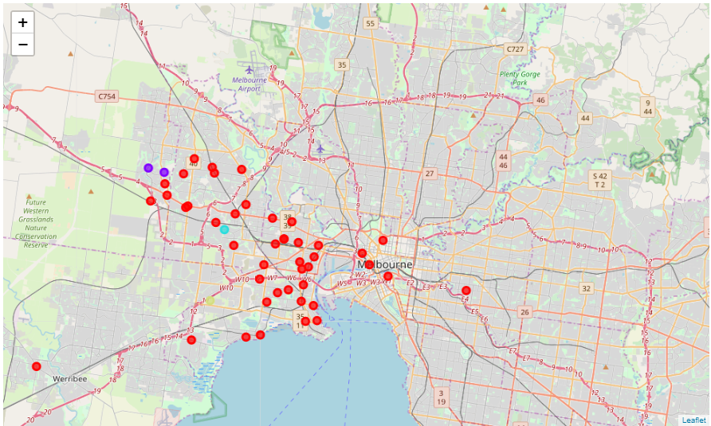
Results
The distribution and clustering of suburbs

Slide 5
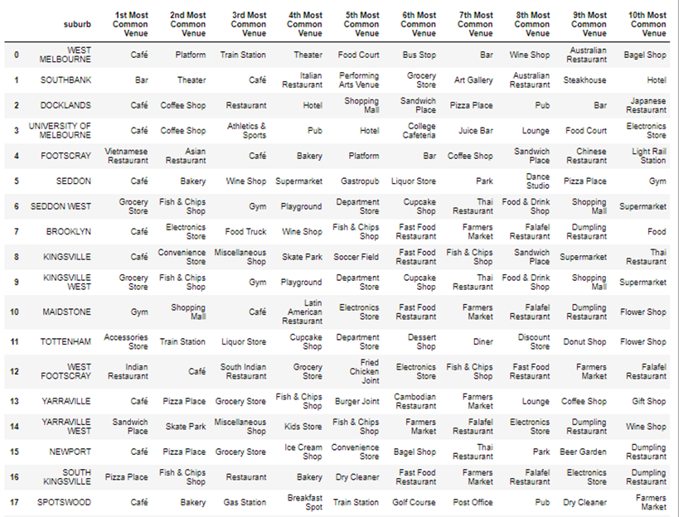
Results – cluster 0
Common venues include:
Bus stop, train stations – suitable for those
who prefer to take public transports
Park, playground, dance studio – may suit
families with children
Markets, shopping malls – convenient for
everyday life

Slide 6
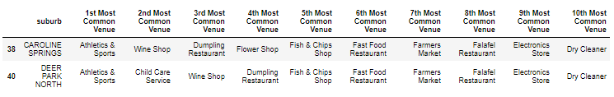
Results – cluster 1
The most common venues:
Athletics & sports – suitable for sporty individuals
Farmers market – convenient for everyday life

Slide 7

Results – cluster 2 & 3
Cluster 2
Cluster 3
Since there is only one suburb being categorised into cluster 2 and cluster 3, we can not identify a clear feature for suburbs in these clusters, in this case those suburbs will be classified as ‘others’.

Slide 8
Conclusion
The suburbs in cluster 0 are more suitable for families with children due to its provision of public transports and facilities for entertainment.
The suburbs in cluster 1 are more suitable for individuals who enjoy sports, since the most common venues belong to the category of ‘athletics and sports ’.
The suburbs in cluster 2 and 3 require further in-depth analysis since their features remain unknown.

